Slide 1
Opportunity Costs

Slide 2
Trade off
A resource is used to produce or consume one good
The same resource cannot be used to produce something else
One good is sacrificed for another

Slide 3
Opportunity Cost
The cost of the trade off
  The value of the next best alternative that is given up to obtain the preferred item
  The next best choice

Slide 4
Trade offs and opportunity costs daily
Two events you want to attend this weekend
  Tickets cost the same amount
  Only enough money to go to one event
  Must make trade-off because you can’t afford both
  You choose Event A, the Opportunity Cost is the alternative choice of buying ticket to Event B

Slide 5
Production Possibilities Curve
Illustration of trade-offs and opportunity costs
Shows all of the possible combinations of two goods or services
Two important assumptions must be met
  The amount of available resources and technology will not change during the period of study
  All natural, human, and capital resources are being used in the most efficient manner possible
More of one good can be produced only by making less of another good

Slide 6
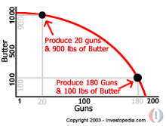

Slide 7
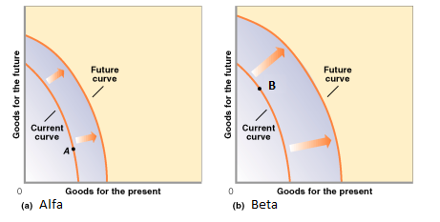
Future Production Possibilities
Improvement in technology occur
New Resources become available
The entire curve shifts to the right

