Slide 1
Demand

Slide 2
The Nature of Demand
Demand: The amount of a good or service that a consumer is willing and able to buy at various possible prices during a given time period
Quantity Demanded: Amount of a good or service that a consumer is willing and able to buy at each particular price during a given time period

Slide 3
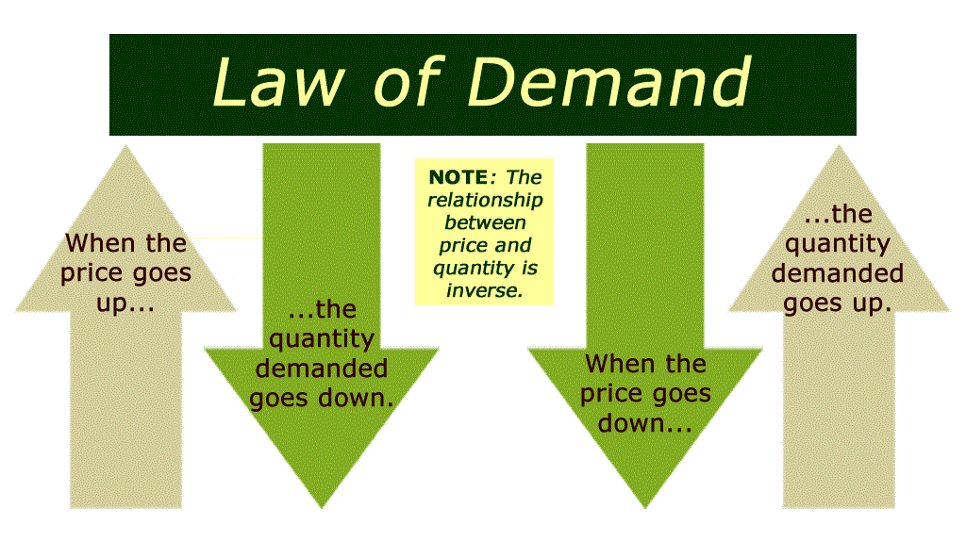
The Law of Demand
Increase in a good’s price causes a decrease in the quantity demanded

Slide 4
Inverse Relationship
Real Income Effect
Purchasing Power – Amount of Money people have available to spend
As purchasing power increases so does demand for goods and services
Income effect – Any increase or decrease in consumers purchasing power caused by a change in price
You have $30
CD’s - $15 to $10. You can now buy 3
CD’s - $15 to $18. You can only buy 1

Slide 5
Inverse Relationship
Substitution Effect
Tendency of consumer to substitute a similar, lower priced product for another product that is more expensive
Price of steak rises – More chicken bought
Milk – No substitute

Slide 6
Inverse Relationship
Diminishing Marginal Utility (Satisfaction)
The natural decreases in the utility of a good or service as more units of it are consumed
Tacos – Buy two at $1 and get third one for $.50
First one is worth it
Second one still worth it as well
Third One – Feel full, only eat because of the special
Fourth One – Can’t eat anymore, would spend no more money on tacos
Demand for a product is not limitless
A limit to a product’s utility to consumers making there a limit to consumers demand

